Slide 1



UDAPTOR
DATA UNCHAINED
Ankush Sharma
Evgeny Pozdeev
Fernando Stefanini
Pablo Lopez
Rene Gomez
Barcelona, 2019

Slide 2

Data Portability: get all your personal data
GDPR came into power in May 2018
GDPR protect and empower all EU citizens data privacy
Data Portability Right is one of the rights
One of the use cases: “to transmit those data to another controller”
GDPR
Even though now people can download their data, there is not much to do with it

Slide 3

Let’s look at this dude
It’s Eric.
This year Spotify launches in his country.
He really wants to switch from Apple Music to Spotify, but he doesn’t want to copy all his playlists by hands.
Also he doesn’t want to get bad recommendations first months.
Eric struggles because he can’t exercise his Data Portability right

Slide 4
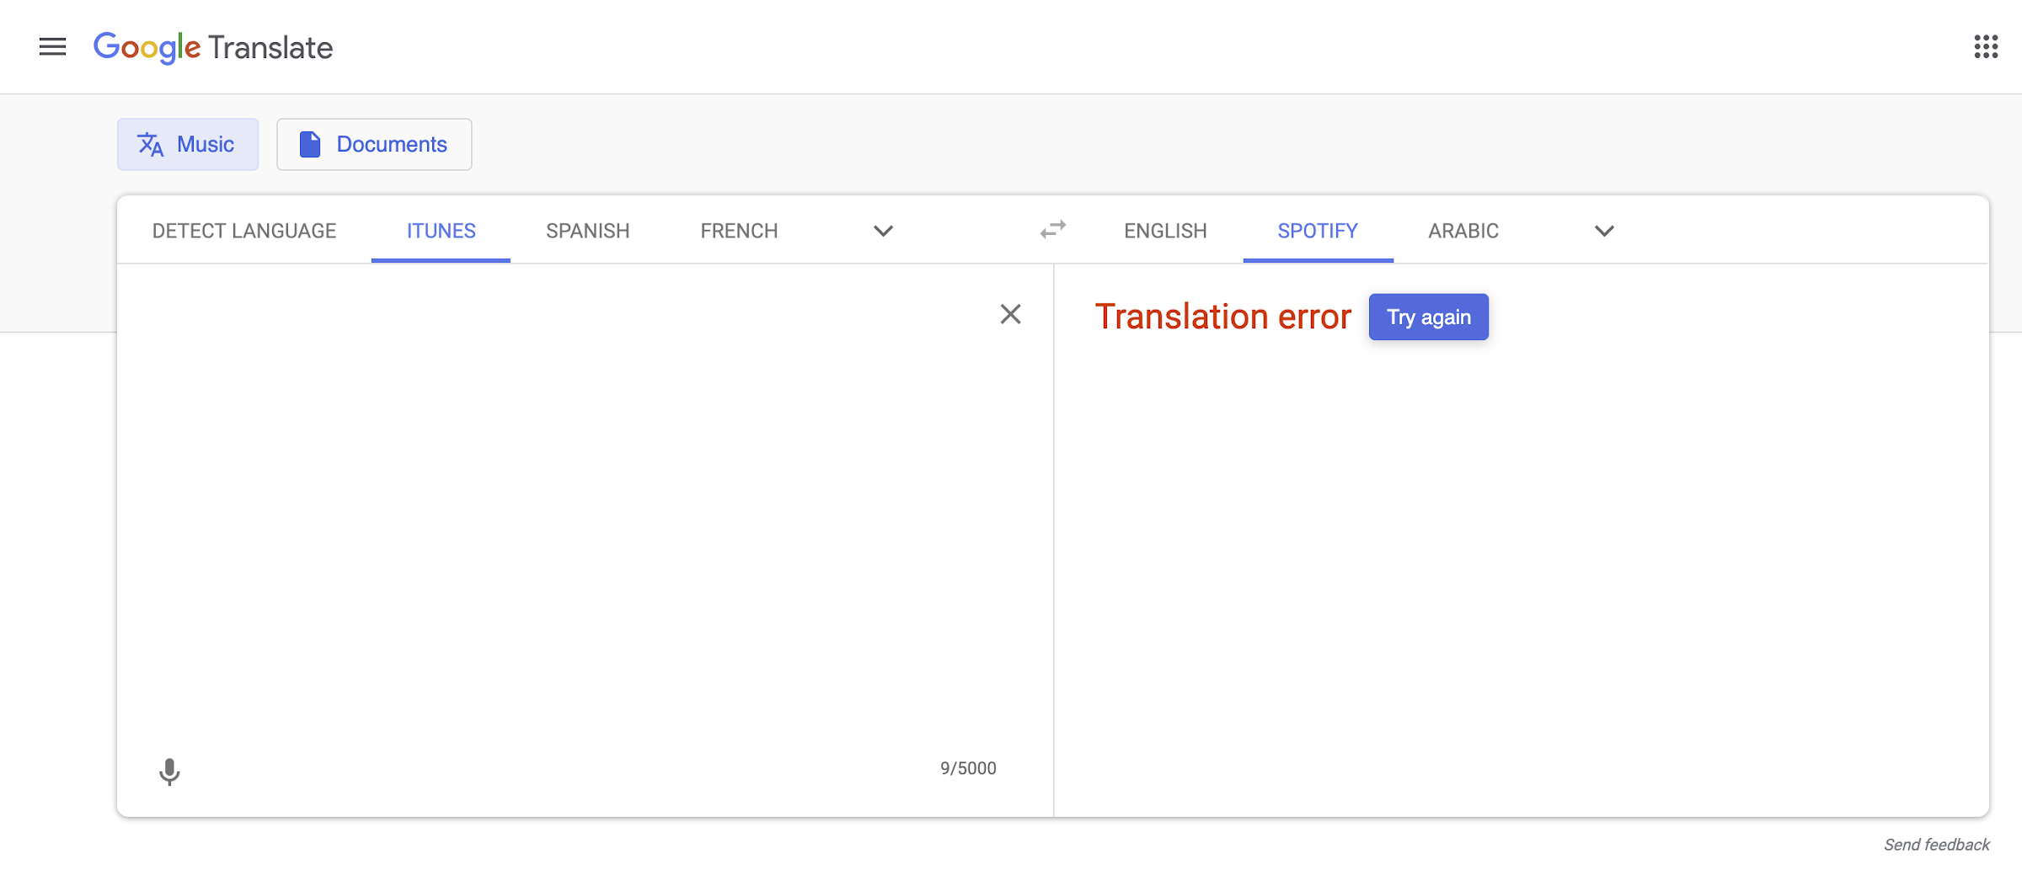
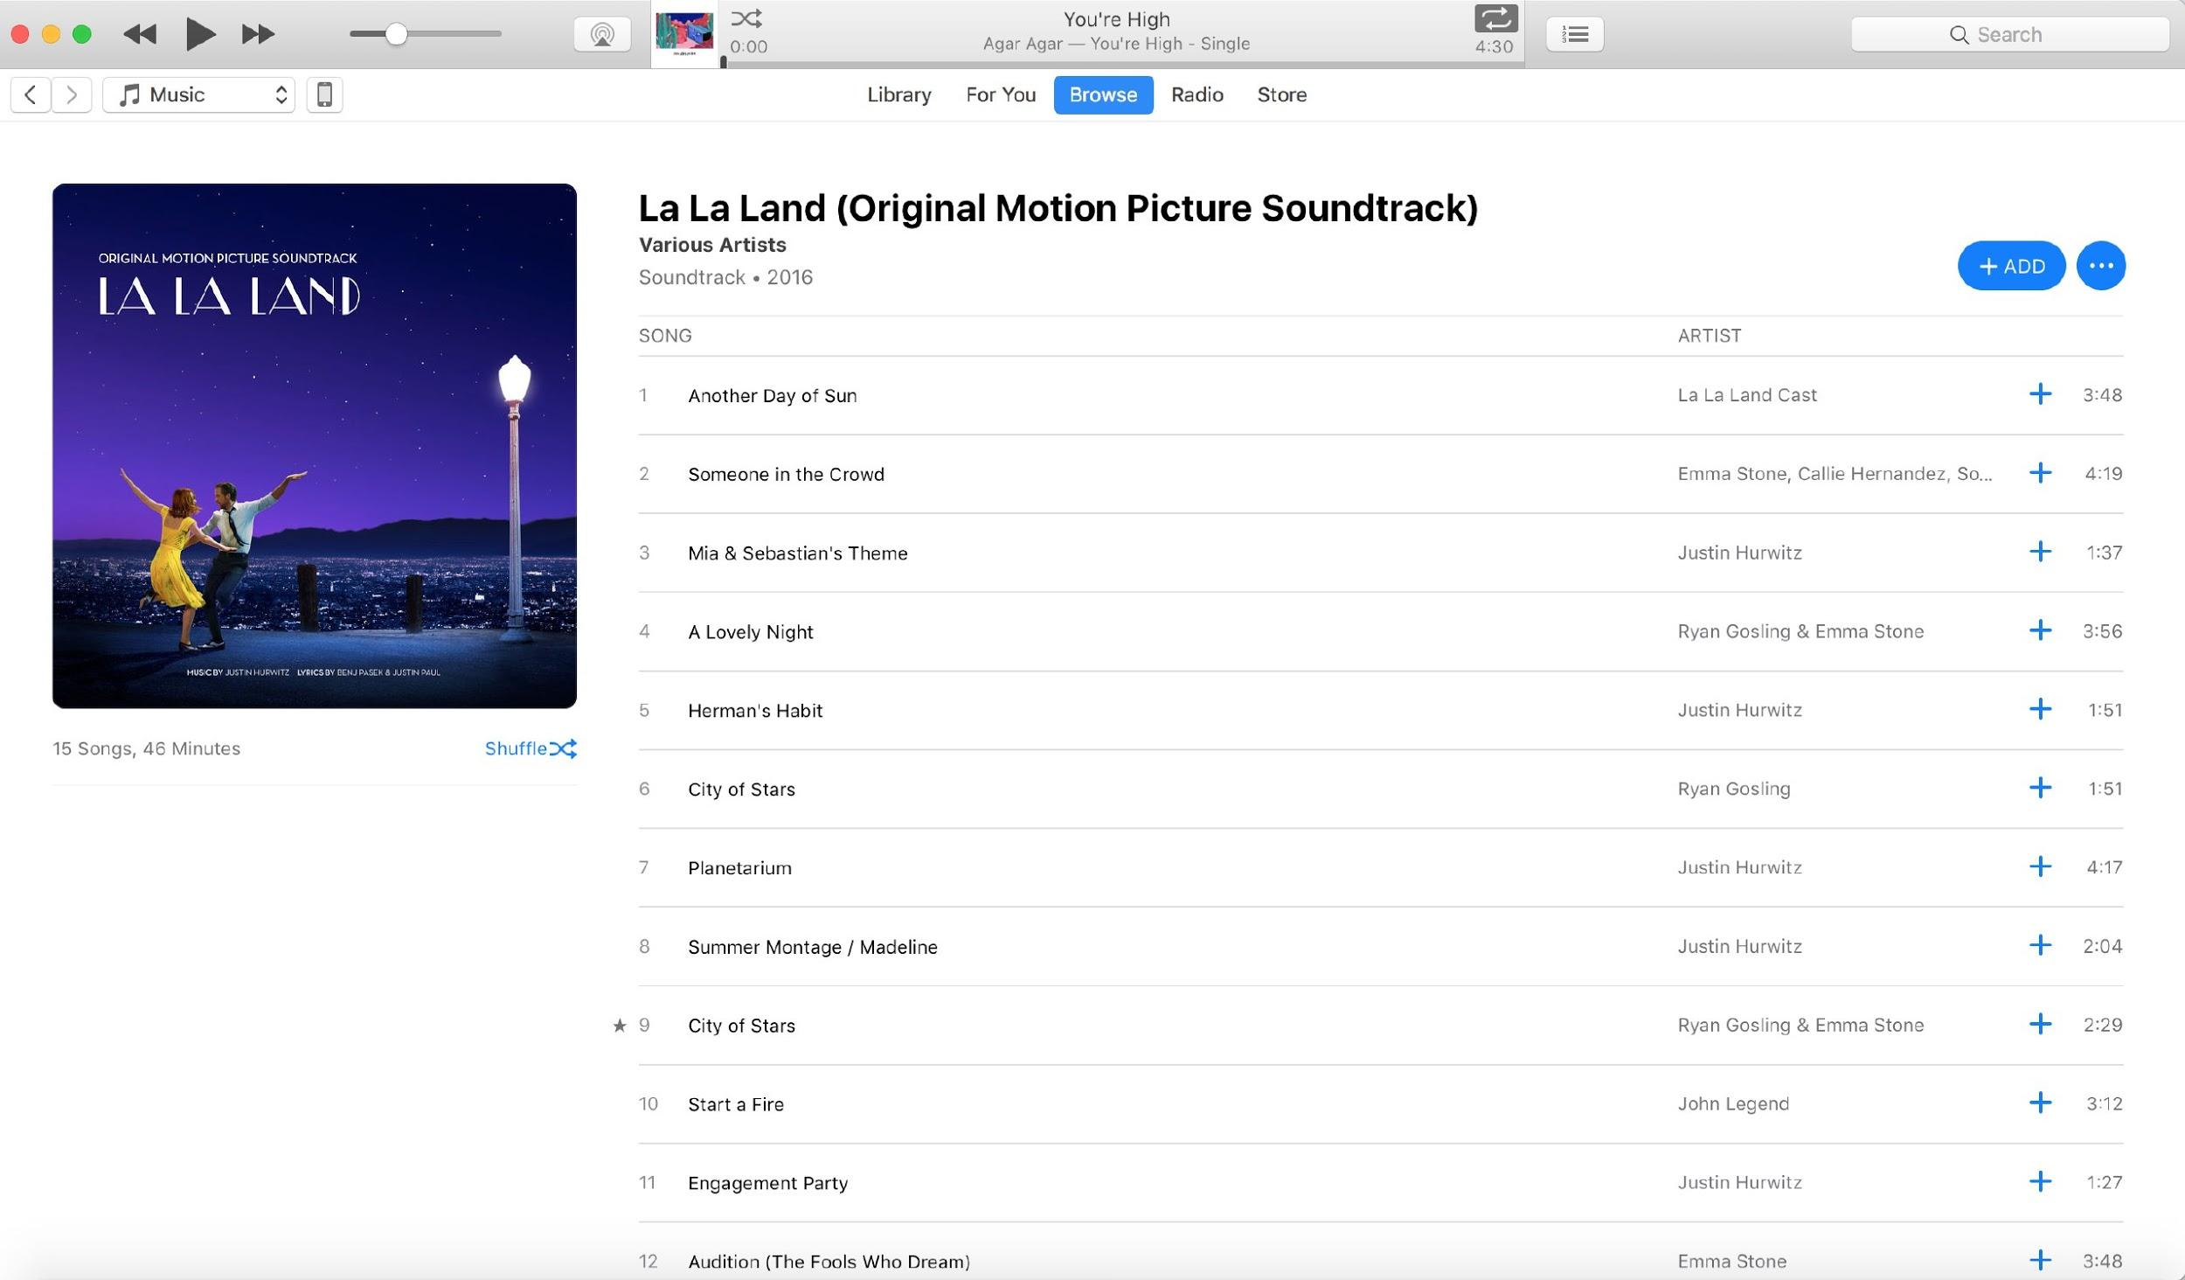
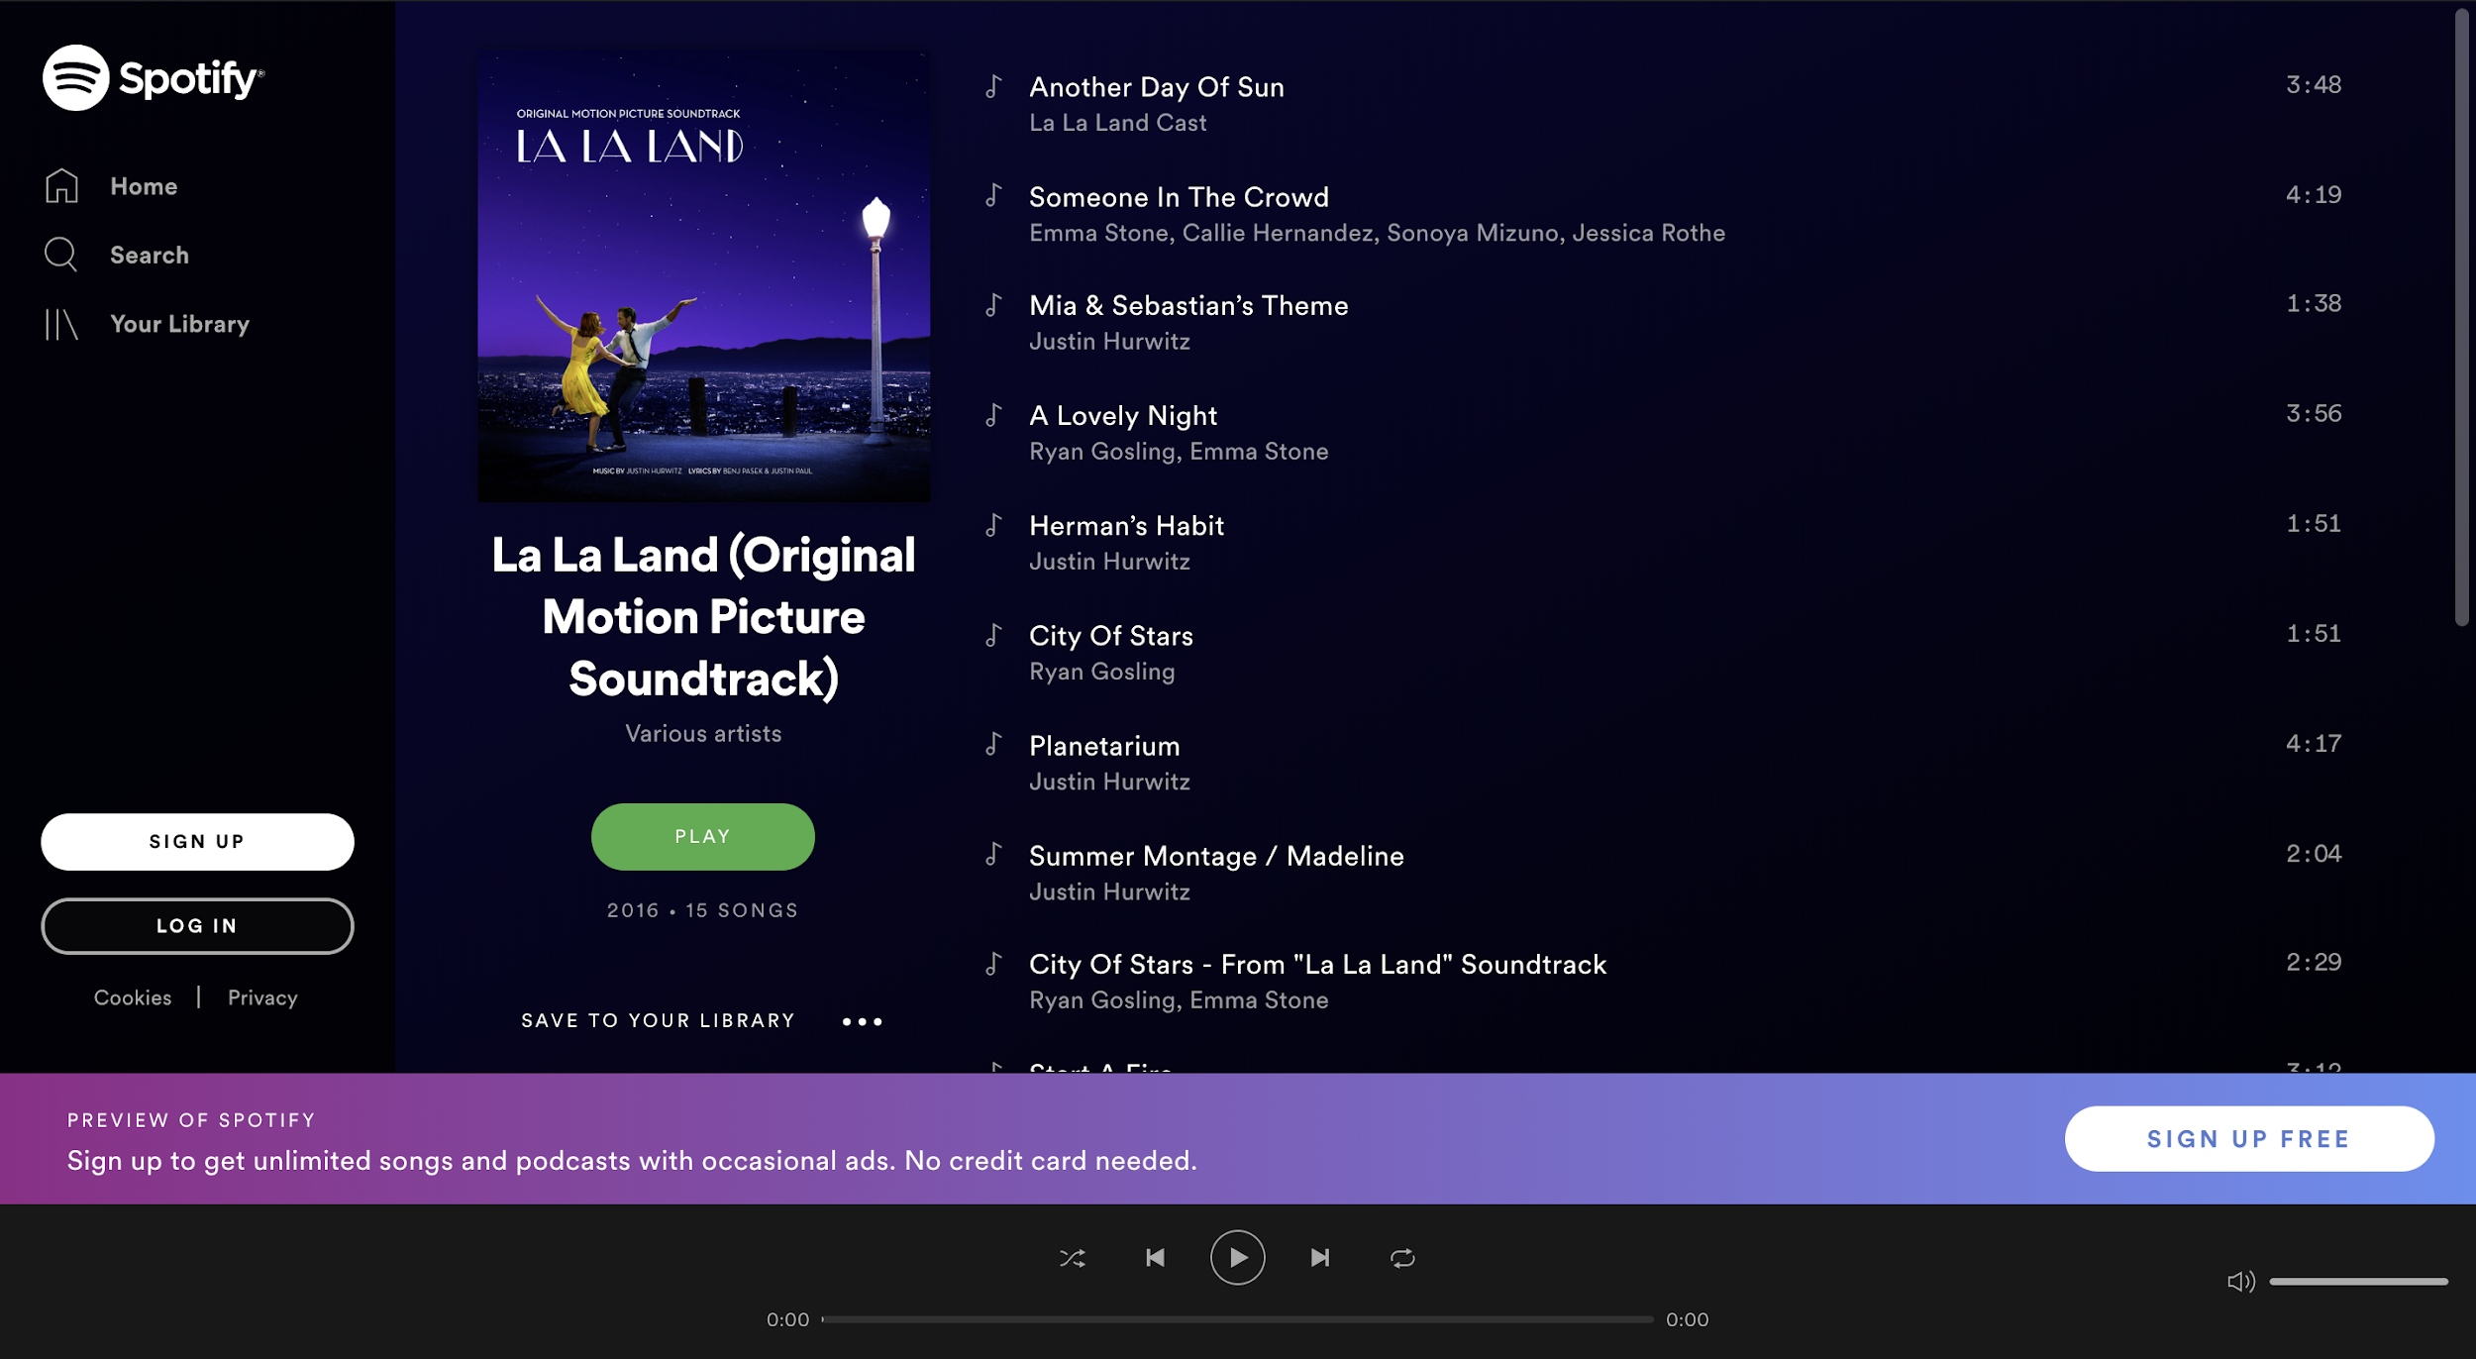
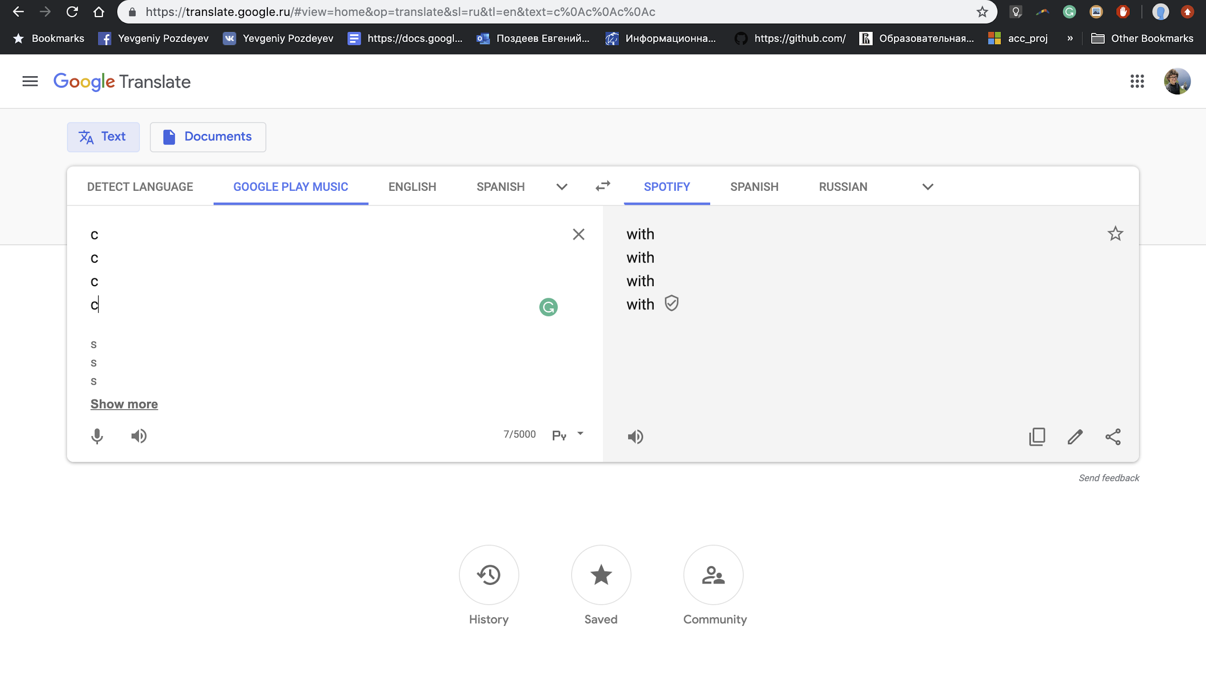
What if Google Translate worked with data?

Slide 5
Let’s come back to our dude
Eric found out that even though he lives not in the EU, his current music provider allows retrieving personal data according to GDPR Art.20.
He got his data and send it to Spotify - so they translated it into the format they can use.
Eric got all his old playlists in Spotify, and, moreover, now he likes his recommended playlists more!

Slide 6
This use case can be scaled further
It’s Emma.
- wants to try out AILetics app
- but she heard that it takes months for AI to actually give useful suggestions.
- requested all her personal data according to GDPR Art.20 and just “translated” her data to the format that AILetics could utilize
- in 3 minutes her new Artificial Intelligence Fitness Trainer gave fine tuned personalized programm.
It’s Paul.
- launched a data-driven app
- it can analyze data and provide his clients with the best service, but needs to have 6 months historical data
- found several companies that accumulate this data
- targeted his advertisements for users of these companies
- most of his new clients came with bid dataset, he just ‘translated’ it to the format he could use in his App. Now he got invitation to join YC!
It’s Sara.
- business struggles from fighting against monopoly
-people can’t use Sara’s service easily, due to high switch cost and network effect.
- connected data translator to webpage of her business
- now all people can retrieve data from the monopolist and easily switch from the monopoly to her service!
- there is no monopoly any more
Is it possible in the real life?

Slide 7



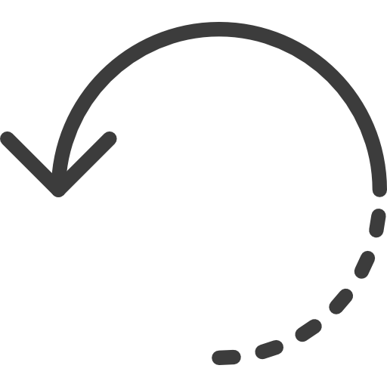

UDAPTOR: just like Google Translate for Data
1.
Potentially unsatisfied user gets his data from previous vendor using GDPR Art.20
5.
Happy user from day-0
And happy new vendor - churn shrinks, retention grows
Music
2.
He provides the new vendor with this data
3.
UDAPTOR transforms data to new format
4.
The new vendor utilizes this data to provide the best service for user

Slide 8




UDAPTOR: just like Google Translate for Data
1.
Potentially unsatisfied user gets his data from previous vendor using GDPR Art.20
5.
Happy user from day-0
And happy new vendor - churn shrinks, retention grows
Taxi
2.
He provides the new vendor with this data
3.
UDAPTOR transforms data to new format
4.
The new vendor utilizes this data to provide the best service for user

Slide 9



UDAPTOR: just like Google Translate for Data
1.
Potentially unsatisfied user gets his data from previous vendor using GDPR Art.20
5.
Happy user from day-0
And happy new vendor - churn shrinks, retention grows
Banks
2.
He provides the new vendor with this data
3.
UDAPTOR transforms data to new format
4.
The new vendor utilizes this data to provide the best service for user

Slide 10
UDAPTOR: from idea to business
Businesses
People
Decreasing churn rate & increasing client loyalty, ability to provide full service from day 0
UDAPTOR
“Transfer data without format restrictions”
UDAPTOR DOESN’T STORES ANY PERSONAL DATA:
Immediate data deletion
End-to-end encryption
Distributed processing
Ability to switch between services easily, increase control over their personal data
Pay per transaction, based on success score
Free to use
How do we see a better world
There is no vendor lock based on data importability
Companies compete in providing better service, not making user’s transition harder (or switch cost higher)
Users can switch between services easily
What will help us to build it
Rapidly growing market opportunities leveraged by GDPR
Lack of direct competitors
Easy-to-scale solution
Position: market democratizer

Slide 11
The Market for UDAPTOR is still establishing
TAM
€2,3B
TAM(Total addressable market) = €2,3B:
5804 data-driven startups with a $4.5M average valuation[REF]
$4,500,000 x 5,804 = $26,118,000,000
Startups spend ~10% of their budget for Marketing[REF]
$26,118,000,000 x 10% = $2,611,800,000
~10%
SOM
€256M
SOM(Serviceable obtainable market) = €256M:
The population of the EU is 512.6M[REF] + assume that 25% of people will switch 1 service in a year and 25% will try out brand new startup
Transaction price = €1
512,600,000 x (25%+25%) * €1 = €256,300,000
We are aiming at market share of ~10% in 4-5 years

Slide 12
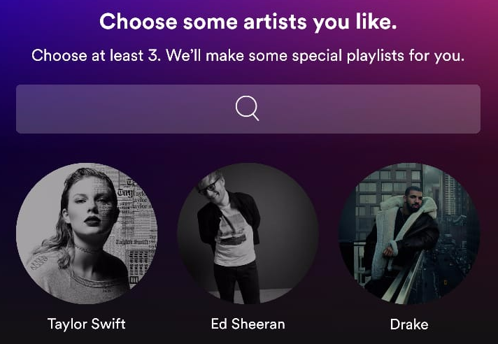


Substitutes are our real and only competitor
1
2
3
Onboarding systems
- Select your favorite music genres and artists
- Find interesting topics and pages
Log in via 3rd parties
- Login via Facebook/Google
- Allow to use your profile picture/email/age/etc.
Suffer
- Get data from client while he is using new service
- Propose bad suggestions, provide feasible service
Most of the companies uses all of them together
Substitutes fulfill the needs at some point, but UDAPTOR can do better

Slide 13
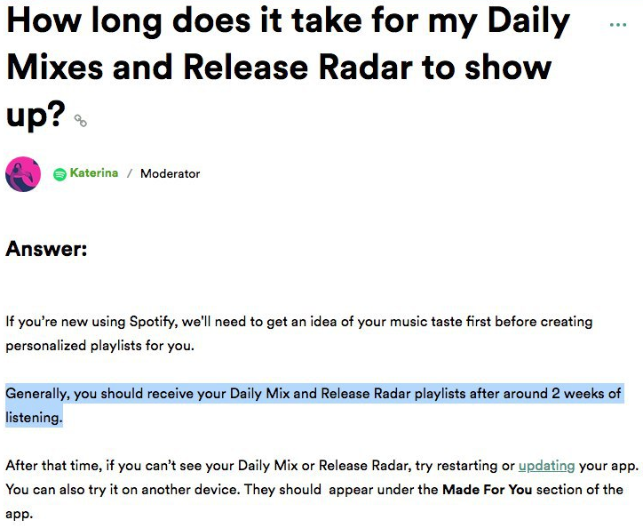
Substitutes are our real and only competitor
1
2
3
Onboarding systems
- Select your favorite music genres and artists
- Find interesting topics and pages
Log in via 3rd parties
- Login via Facebook/Google
- Allow to use your profile picture/email/age/etc.
Suffer
- Get data from client while he is using new service
- Propose bad suggestions, provide feasible service
Most of the companies uses all of them together
Substitutes fulfill the needs at some point, but UDAPTOR can do better

Slide 14




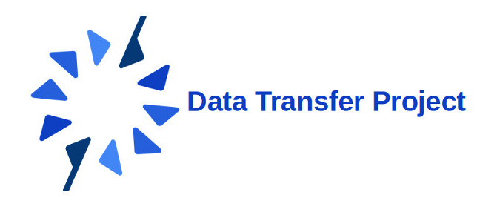

Competitors
1
2
Direct
(1) Digi.me
(2) OneCub
(3) Data Transfer Project
Indirect
(1) DataCoup
(2) Zapier
(3) PrivacyAudit

Slide 15
Competitors
1
2
Direct
(1) Digi.me
(2) OneCub
(3) Data Transfer Project
Indirect
(1) DataCoup
(2) Zapier
(3) PrivacyAudit
The most active (hiring, developing, content creation)
The most closest in terms of business model
(1) Digi.me

Slide 16
Competitors: Digi.me
an application for users to collect and store personal data
developers SDK for integrating existing sources
private sharing platform for companies to use user’s data
Businesses can utilize this data under users' consent, paying per transaction (for both giving and getting data)
Clients (people) can manage their private data in a convenient way for free
But...
Analysis of digi.me showed that they use APIs to get data. In most of the cases APIs don’t provide access to all data, where UDAPTOR propose working with full datasets.
Moreover, there is no evidence that digi.me is using same family of technologies, consequently, digi.me doesn’t have same scaling opportunities
Current competition on the market is represented by small set of companies None of them can handle competition in scalability with UDAPTOR

Slide 17
The secret sauce
Smart Core: technology for data integration automation ...
… allow us to use 2 types of scaling:
“Horizontal”
Even with current level of automation we can integrate clients in parallel: it’s the matter of specialists.
“Vertical”
Product development is focused on automating data integration: this will allow us to provide service for more Clients with the same team
5-level pipeline:
1) automizible - current automation ~20%
2) adjustable - changes in data format/schema/ naming won’t affect the pipeline
The secret sauce leads us towards our unfair advantages: Scaling effect
and, as a consequence and due to industry specifications, Network effect

Slide 18




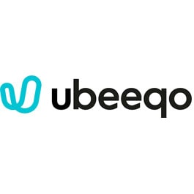

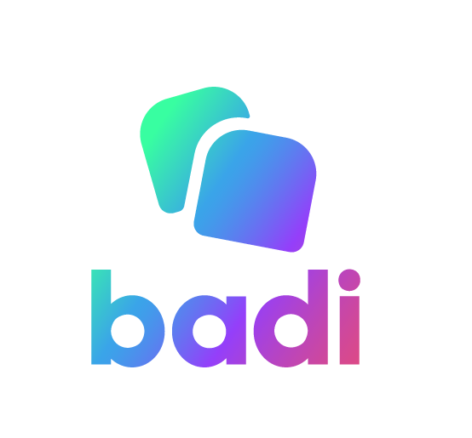






GO2MARKET: client segmentation
All our Clients has to be: GDPR-compliant and Data-driven business. In addition to that:
Competition on saturated market
Entering new market
Breaking the monopoly
Bringing innovative idea
- Large enterprise
- Working on saturated market
Content streaming (music, podcasts, video)
- Large business
- Entering new geographic market
Transportation (taxi, car/velo/scooter sharings)
- Small business
- Struggles with fighting against monopoly
Housing
- Small start up
- Core function is based on data-driven decisions
Deep learning based
Examples

Slide 19
GO2MARKET: client segmentation
Large
“Competition on saturated market”
“Entering new market”
Size of the company
“Bringing innovative idea”
“Breaking the monopoly”
Small
Indirect
Market competition
Direct

Slide 20
GO2MARKET: client segmentation
Large
“Competition on saturated market”
“Entering new market”
Size of the company
“Bringing innovative idea”
“Breaking the monopoly”
Focus #1:
“Hey, want some data?”
Small
Indirect
Market competition
Direct

Slide 21
GO2MARKET: client segmentation
Large
“Competition on saturated market”
Focus #2:
“Hey, do you know where did your customers go?”
“Entering new market”
Size of the company
“Bringing innovative idea”
“Breaking the monopoly”
Small
Indirect
Market competition
Direct

Slide 22
€
€€_
GO2MARKET: Pricing
Selected approach: transactional dynamic pricing with success fee base
Basic
from €0.75 to €1.5
per transaction
-
1 data integration = €1000
-
Regular
from €0.45 to €1.0
per transaction
after 55000 tr/month
price is €0.45 fixed
3 free data integrations
not more than 7.5% RGBU
Premium
from €0.35 to €0.8
per transaction
after 35000 tr/month
price is €0.35 fixed
10 free data integrations
not more than 5.0% RGBU
*
FREE TIER
1000 transactions from integrated data sources
**
(*) – depending on amount of data being transferred
(**) – Revenue generated by users

Slide 23
Where will UDAPTOR be in 2 years?
 | Spotify (L) | Start up (S)
Served users per month | 55775 | 2500
Served users per year | 669,296 | 30000
Users generated revenue | €8,031,552 | €900,000
if Basic | €826,410 | €37,042
if Regular | €542,482 | €24,167
if Premium | €401,578 | €19,228
Average monthly transaction
(if Regular / 12):
S = €2,014
L = €45,207

Slide 24
Where will UDAPTOR be in 2 years?
year | month | Sales S | Sames L | Revenue
1 | 1 | 0 | 0 | €0
 | 2 | 0 | 0 | €0
 | 3 | 0 | 0 | €0
 | 4 | 0 | 0 | €0
 | 5 | 0 | 0 | €0
 | 6 | 0 | 0 | €0
 | 7 | 1 | 0 | €2,014
 | 8 | 0 | 0 | €2,014
 | 9 | 0 | 0 | €2,014
 | 10 | 1 | 0 | €4,028
 | 11 | 0 | 0 | €4,028
 | 12 | 0 | 0 | €4,028
Total year 1: |  | 2 | 0 | €18,126
year | month | Sales S | Sames L | Revenue
2 | 1 | 1 | 0 | €6,042
 | 2 | 2 | 0 | €10,070
 | 3 | 1 | 0 | €12,084
 | 4 | 2 | 0 | €16,112
 | 5 | 2 | 0 | €20,140
 | 6 | 2 | 0 | €24,167
 | 7 | 2 | 1 | €73,402
 | 8 | 3 | 0 | €79,444
 | 9 | 2 | 0 | €83,472
 | 10 | 3 | 1 | €134,721
 | 11 | 4 | 0 | €142,776
 | 12 | 3 | 0 | €148,818
Total year 2: |  | 27 | 2 | €751,248

Slide 25
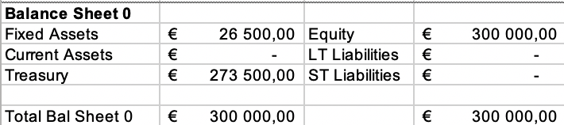
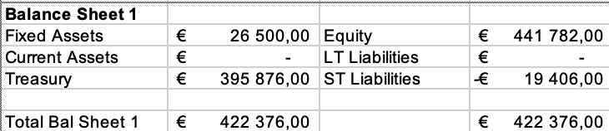
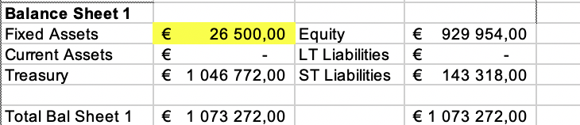
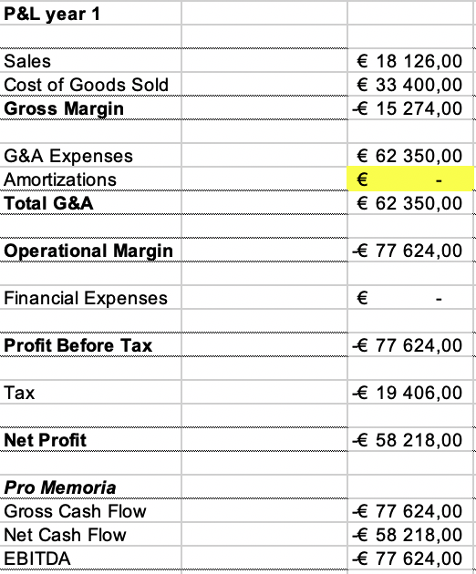
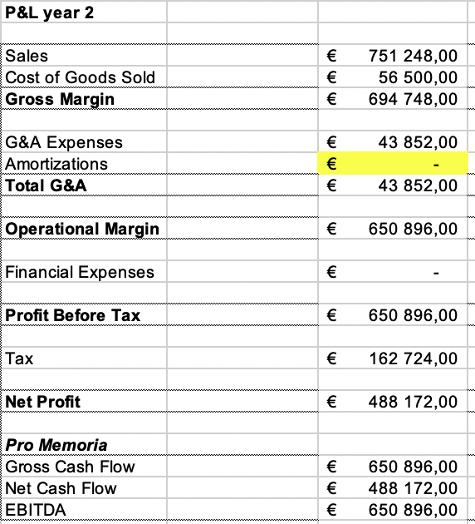
Where will UDAPTOR be in 2 years?

Slide 26
Where will UDAPTOR be soon?
Automation | time for 1 client | # clients per month | 01 | 02 | 03 | 04 | 05 | 06 | 07 | 08 | 09 | 10 | 11 | 12 | total tranches | total yearly revenue
20% | 1 month | 1 | 1 | 1 | 1 | 1 | 1 | 1 | 1 | 1 | 1 | 1 | 1 | 1 | 78 | $463,365
40% | 2 weeks | 2 | 2 | 2 | 2 | 2 | 2 | 2 | 2 | 2 | 2 | 2 | 2 | 2 | 156 | $926,730
60% | 1 week | 4 | 4 | 4 | 4 | 4 | 4 | 4 | 4 | 4 | 4 | 4 | 4 | 4 | 312 | $1,853,460
80% | 1 day | 20 | 20 | 20 | 20 | 20 | 20 | 20 | 20 | 20 | 20 | 20 | 20 | 20 | 1560 | $9,267,302
x2
x4
x20

Slide 27
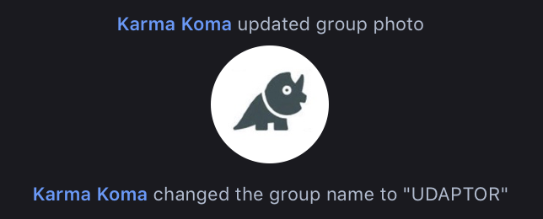

Where will UDAPTOR be in 2 years?
Final presentation of VBP project:
- prototype is implemented
- proof of concept is running
- finalized idea of business (with financial documents and value proposition)
- summer plan is ready
- proposition to investors is ready
- 2+ small clients, first continuous revenue
- multiple leads
- queue of data providers to integrated
- beta-version is automized to ~40-50%
The idea were born
-2 months
-2 months
+3 months
+1 year
+1 year
...
...
17-03-2019
17-06-2019
- 1-3 startups working with us for free: as a part of marketing campaigns and CustDev
- prototype is developed to beta-version
- ‘warmed up’ channels for lead generation
- registered as business entity
- level of automation is 60%+
- several large clients
- social recognition
- annual revenue ~€0.7M
Data retrieval, implementation started, market research started
Today

Slide 28
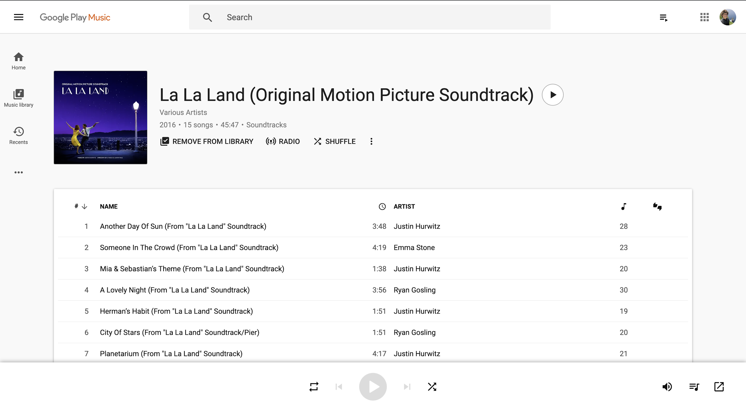
You might think that UDAPTOR is this
Bringing innovative idea
Breaking the monopoly
Entering new market
Competition on saturated market
 | Spotify (L) | Start up (S)
Served users per month | 55775 | 2500
Served users per year | 669,296 | 30000
Users generated revenue | €8,031,552 | €900,000
if Basic | €826,410 | €37,042
if Goal | €542,482 | €24,167
if Premium | €401,578 | €19,228

Slide 29










But UDAPTOR is this
Ankush Sharma
Evgeny Pozdeev
Fernando Stefanini
Pablo Lopez
Rene Gomez
Head of Technology
- BS in Mathematics, University of Delhi, India
- 4+ years working experience on high performance distributed systems
Executive Manager
- BS in Software Engineering, Higher School of Economics, Russia
- 2+ years experience in multiple industries; worked for McKinsey, Google and Accenture
Head of Operations
- BS in Information System, University of São Paulo, Brazil
- 6+ years of experience on Cobli (logistics start up), Ericson and Facebook
Head of R&D
- BS in Computer Engineering, University of Asunción, Paraguay
- 5+ years of working experience on system development and R&D
Product Manager
- BS in Systems and Computing Engineer, Technical University of Pereira, Colombia
- 8+ years of working experience as system architect in different sectors

Slide 30

Want to join our team?
Estimated budget: €300’000
UDAPTOR team will invest €25’000
the Investor to enter the business with €275’000
For all shareholders, we propose 3 installments: 20%, 30%, and 50% for month 1, 7 and 13.
installment | month | proportion of total investment | founders | investor | total
1 | 0 | 20% | €5,000 | €55,000 | €60,000
2 | 6 | 30% | €7,500 | €82,500 | €90,000
3 | 12 | 50% | €12,500 | €137,500 | €150,000
TOTAL |  |  | €25,000 | €275,000 | €300,000
we offer the investor share of 12%

Slide 31
DEMO and...
Q&A
Q&A
Ping us on info@udaptor.io … or visit udaptor.io

Slide 33
Example:
Gmail + Chrome + Android + Maps + Drive => ~20 GB of data
each step of your life. From your daily trace to the history of your waking ups
We are estimating our market share ~10% in 2-3 years

Slide 34
Example:
Gmail + Chrome + Android + Maps + Drive => ~20 GB of data
each step of your life. From your daily trace to the history of your waking ups
1.
Potentially unsatisfied user gets his data from previous vendor using GDPR Art.20
5.
Happy user from day-0
And happy new vendor - churn shrinks, retention grows
2.
He provides the new vendor with this data
3.
UDAPTOR transforms data format
4.
The new vendor utilizes this data to provide the best service for user

Slide 35
GO2MARKET: Pricing
Final price = min( # of transactions * price per transaction + data correction - discount; $ of the revenue generated by users)
 | Basic | Regular | Premium
per transaction | 0.75 | 0.45 | 0.35
per data amount | plus up to 0.75 | plus up to 0.55 | plus up to 0.45
monthly discount after transactions: | - | 55000 | 35000
ALL ABOVE OR user-generated % | - | 7.5% | 5.0%
features: | 1) no data sharing with us 2) no discount discount 3) new data source €1000 | 1) share some data (ARPU) 2) discount 3) 3 free new data sources | 1) share data about users that we brought 2) better discount 3) 10 free new data sources

Slide 36
This use case can be scaled further
It’s Emma.
Emma really wants to try out brand new Artificial Intelligence fitness trainer AILetics, but he heard that it takes months for AI to actually give useful suggestions.
Emma has no chance, but continue using the app that everybody uses.
Emma requested all her personal data according to GDPR Art.20 and then just “translated” her data to the format that AILetics could utilize. Within several minutes her new Artificial Intelligence Fitness Trainer knew about Emma enough information to give fine tuned personalized programm.
It’s Paul.
Paul recently launched a startup: very cool data-driven application with Artificial Intelligence; it can analyze data and provide his clients with the best service! The problem is that Paul can’t do it from the beginning: data needs to be collected for at least 6 months…
Sara connected data translator to webpage of her business - now all people can retrieve their personal data from the monopolist and easily switch from the monopoly to her service! Switch cost dropped significantly, the competitor-monopolist started to lose clients rapidly, it’s not a monopoly any more.
It’s Sara.
Sara’s business struggles from fighting against monopoly: most of the people uses large market player’s service, even though she can provide it better. People can’t use Sara’s service easily, due to high switch cost and network effect.
Paul found several companies that accumulate the data that he need, targeted his advertisements for users of these companies. Most of his new clients came with bid dataset, requested according to GDPR, and Paul just ‘translated’ data to the format he could use in his App. Now he got invitation to join YC!

